Slide 1
SAVE NEW YORK CITY TREES
Tree Census ! 2015

Slide 2
TABLE OF CONTENTS
ABOUT PROJECT
EDA
01
02
MODEL
RECOMMENDATIONS
03
04
Data socurce and cleaning
Explatory data analysis
Machine learning models developed
Results and next steps recommendations

Slide 3
01
ABOUT PROJECT
Tree Census ! 2015

Slide 4
INTRODUCTION
The aim of this project is to support New York City Parks Deparment efforts of Urban Forest to reduce climate and air pollution by predicting the health of the trees. The early detection will provide an opprotunity to mitigate any conditions that are causing poor health in a tree.

Slide 5
“Each year NYC's street trees reduce summer electricity use from shading by 50,000 MWh.”
Every tree matters !

Slide 6
Problem Statement : Predict the health status of trees in New York City
Good
Fair
Poor

Slide 7
02
EDA
Exploratory Data Analysis

Slide 8
EDA
One City I Five Boroughs I 666,134 Trees
81% of trees are in good health
Most common species – London Planetree
Chinese Chestnut, Atlas Cedar and Red Pine have least poor health trees.

Slide 9
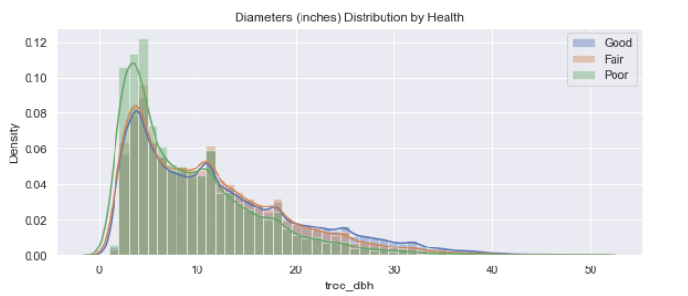
Most trees are less than 50 inches in diameter Distribution

Slide 10
EDA
Most of the trees are planted on the curb
Most common problem in the tree is related to stones
Manhattan has highest number of trees in poor health

Slide 11
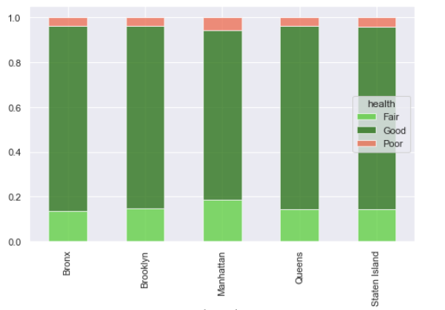
Tree Health by Borough

Slide 12
Problems in tree
02
01
TRUNK
BRANCH
03
04
ROOT
OTHERS
Problems casued by wire, rope,lights, or other trunk problems
Problems caused by lights, wire, shoes, or other brnaches problems
Problems casused by paving stones, metal grates,other root problems
Gurads around trees, sidewalk damage adjacent to tree

Slide 13
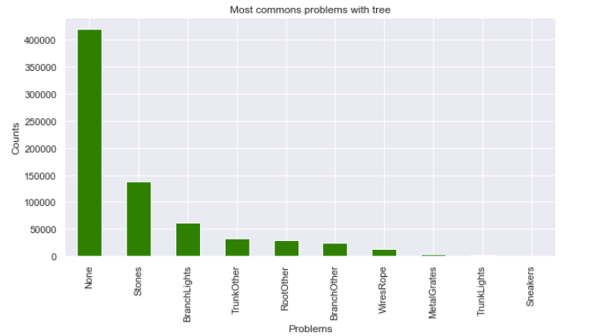
Most common problems in trees

Slide 14
03
MODEL
Predicting the health of trees

Slide 15
Intial Models – Comparsions
Models | Logistic Regression |  | K-Nearest Neighbor |  | Decision Tree |  | Random Forest |  | Gradient Boosting
 | Train Accuracy - 0.81 |  | Train Accuracy - 0.85 |  | Train Accuracy - 0.99 |  | Train Accuracy - 0.99 |  | Train Accuracy – 0.81
 | Test Accuracy - 0.81 |  | Test Accuracy - 0.80 |  | Test Accuracy - 0.74 |  | Test Accuracy - 0.81 |  | Test Accuracy – 0.81
 | Recall | Precision | Recall | Precision | Recall | Precision | Recall | Precision | Recall | Precision
Good | 1.00 | 0.00 | 0.94 | 0.85 | 0.85 | 0.86 | 0.96 | 0.85 | 1.00 | 0.81
Fair | 0.00 | 0.00 | 0.25 | 0.40 | 0.31 | 0.30 | 0.20 | 0.47 | 0.01 | 0.51
Poor | 0.00 | 0.00 | 0.06 | 0.38 | 0.18 | 0.17 | 0.12 | 0.39 | 0.03 | 0.48

Slide 16
Dealing with data imbalance
Random Forest Models | Random Oversampling |  | SMOTE |  | Borderline SMOTE |  | AdaSYN
 | Train Accuracy - 0.81 |  | Train Accuracy - 0.99 |  | Train Accuracy - 0.99 |  | Train Accuracy - 0.99
 | Test Accuracy - 0.81 |  | Test Accuracy - 0.87 |  | Test Accuracy - 0.89 |  | Test Accuracy - 0.86
 | Recall | Precision | Recall | Precision | Recall | Precision | Recall | Precision
Good | 0.99 | 0.89 | 0.93 | 0.85 | 0.93 | 0.86 | 0.93 | 0.85
Fair | 0.91 | 0.99 | 0.79 | 0.87 | 0.83 | 0.90 | 0.77 | 0.87
Poor | 1.00 | 0.98 | 0.91 | 0.90 | 0.93 | 0.94 | 0.91 | 0.89

Slide 17
Random Forest Model Post Random Sampling and Grid SearchCV
Random Forest | Random Forest
Train Accuracy - | Train Accuracy - 0.99
Test Accuracy - | Test Accuracy - 0.81
 | Recall | Precision
Good
Fair
Poor

Slide 18
04
Next Steps

Slide 19
Next Steps
Incorporate data from previous census years - 2005, 1995
Explore deep learning models

Slide 20
THANKS!
Do you have any questions?
parijat.bhardwaj@gmail.com
Please keep this slide for attribution

